Slide 1
Traffic Volume Prediction at Highway Tollgates Dhaval, Mi Tian,Deepan
KDD CUP 2017

Slide 2
Outline
Introduction
Exploration
Regression
Advanced Methods (DEEPAN & DHAVAL)
Conclusion

Slide 3
Introduction

Slide 4
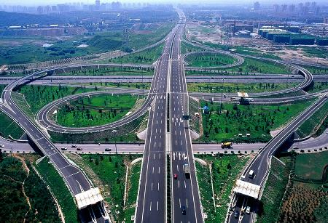
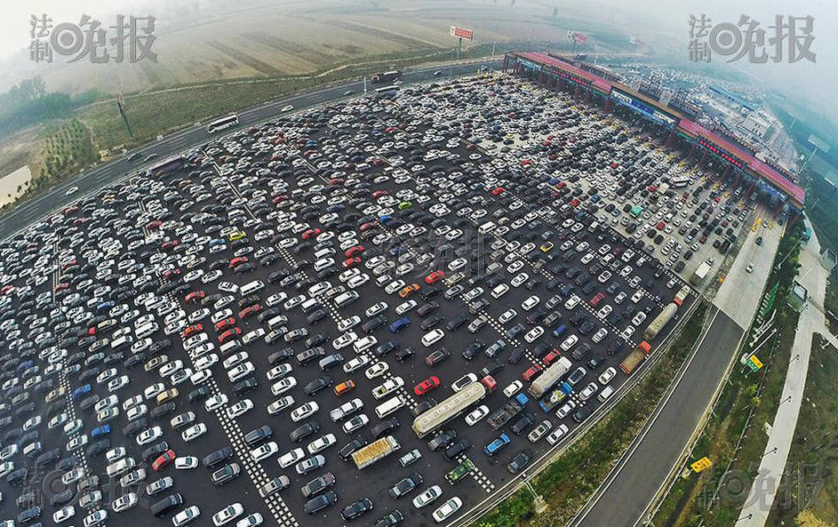
Motivation
Introduction
Tollgates are primary bottlenecks of highway traffic
Predict rush hour traffic can enable better preparation
Dependent on many different factors
Road network enter and exit the tollgates
Rush hour, weekday vs. weekend, holiday
Weather, big events

Slide 5
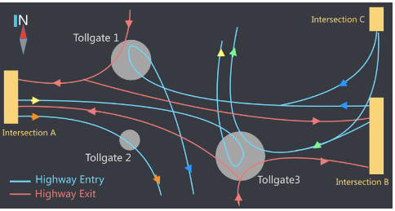
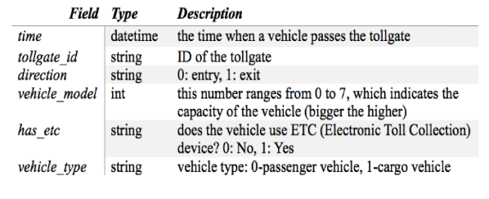
Data
Introduction
Task 2 of KDD CUP 2017
Highway network
Training dataset
Sep 19 – Oct 17 (4 weeks)
Each passing vehicle
Travel time in road sections

Slide 6
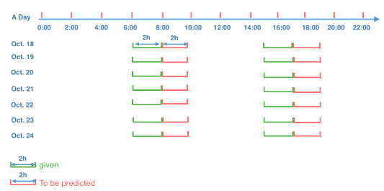
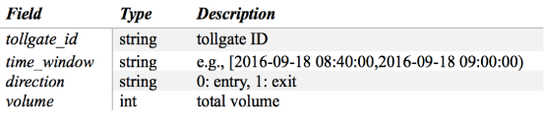
Goal
Introduction
Volume Prediction
Oct 18 – Oct 24
Rush hour (8-10AM, 5-7PM)
20-minute interval
Test dataset
Given volume of previous two hours (6-8AM, 3-5PM)

Slide 7
Exploration

Slide 8
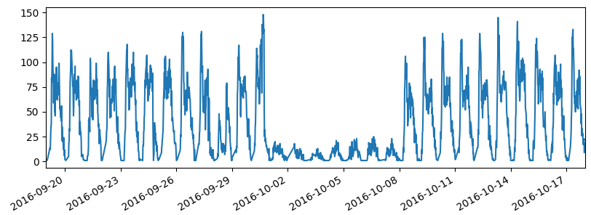
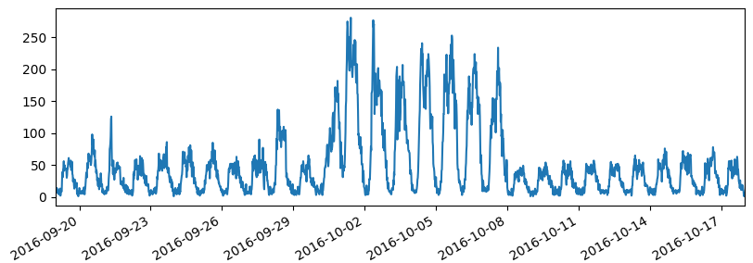
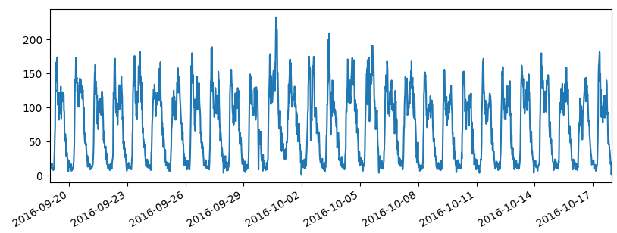
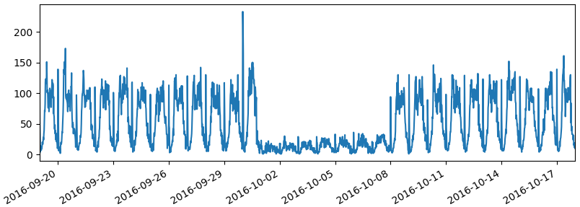
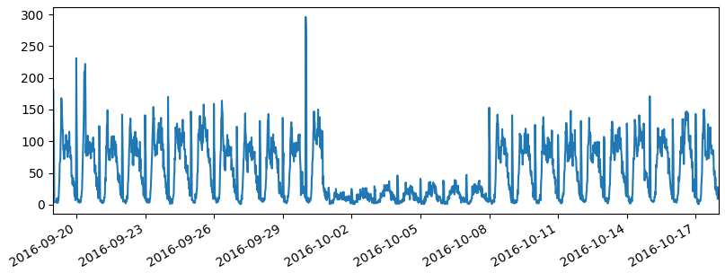
Line Plots
Exploration
Aggregated volume into 20-minute intervals
Plotted for each “Gate & Direction” combination
Gate 2 ENTRY
Gate 1 ENTRY
Gate 3 ENTRY
Gate 1 EXIT
Gate 3 EXIT

Slide 9
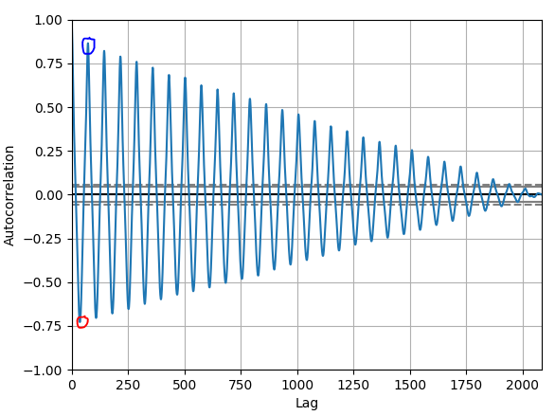
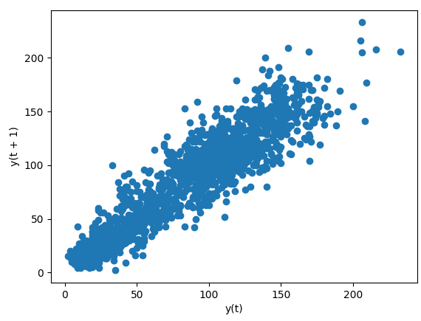
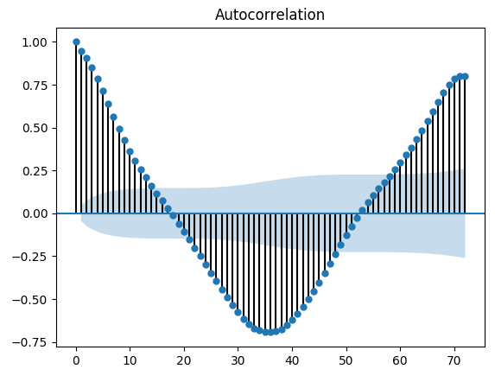
Correlation Plots (unfiltered)
Exploration
Gate 3 Entry
No special holiday pattern
Un-filtered volume data
Lag Plots
(t = 1, or 20 minute)
Auto Correlation Plots

Slide 10
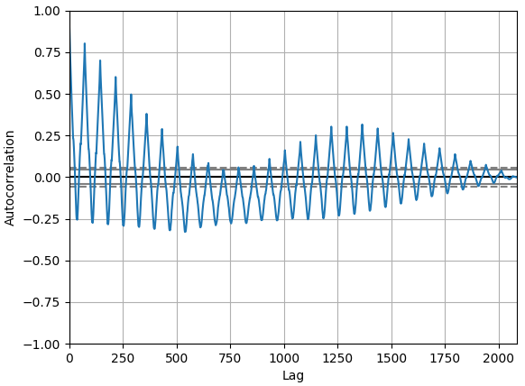
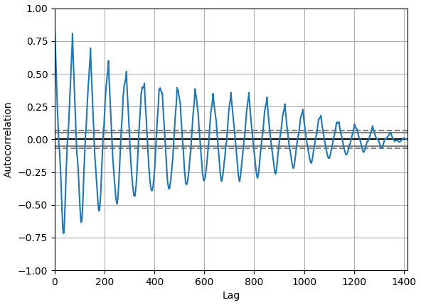
Correlation Plots (no holiday)
Exploration
Before vs. After filter out holiday week data (Gate 1 Exit)
Volume trend is more stationary after removing holiday week data
Similar improvement for other “Gate & Direction” combinations
All data
No holiday week

Slide 11
Regression

Slide 12
Regression Model
Regression
Stationary day-to-day pattern hints regression analysis
Fit training data into regression models
Special holiday week, probably should remove
For KDD CUP, probably only use rush hour data
Attempted AR and ARMA
Simple and preliminary prediction methods
Can be further improved with more features and advanced algorithms

Slide 13

Local Evaluation
Regression
Purpose
Does removing holiday week help improve accuracy?
Does focusing on rush hour data help improve accuracy?
KDD CUP website generate MAPE only once a day
Separate given 09/19 to 10/17 data into two parts
09/19 – 10/10: Training data, used to train model and predict next week
10/11 – 10/17: Test data, used to evaluate prediction accuracy

Slide 14
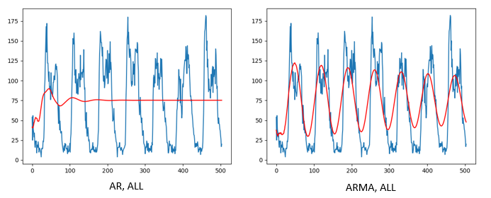
AR/ARMA (with all data)
Regression
Method | MAPE
AR (ALL) | 1.703
ARMA (ALL) | 1.045

Slide 15
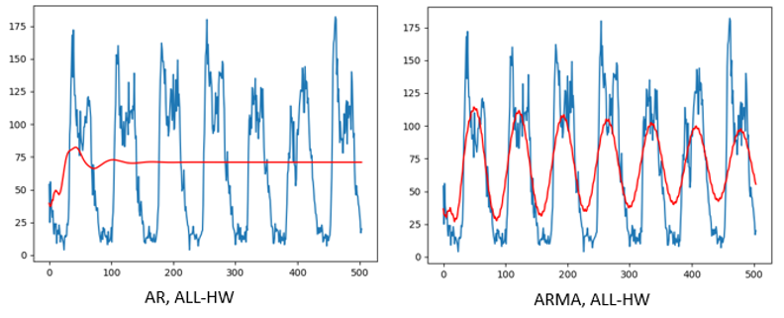
AR/ARMA (no holiday)
Regression
Method | MAPE
AR (ALL) | 1.703
ARMA (ALL) | 1.045
AR (ALL-HW) | 1.610
ARMA (ALL-HW) | 0.761

Slide 16
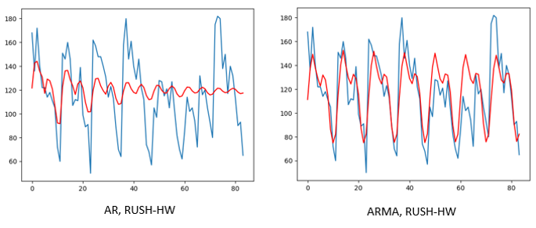
AR/ARMA (rush hour, no holiday)
Regression
Method | MAPE
AR (ALL) | 1.703
ARMA (ALL) | 1.045
AR (ALL-HW) | 1.610
ARMA (ALL-HW) | 0.761
AR (RUSH-HW) | 0.228
ARMA (RUSH-HW) | 0.191
KDD CUP Result
0.2647
(used all four weeks’ data)

Slide 17
Advanced Methods
(DEEPAN, DHAVAL)

Slide 18
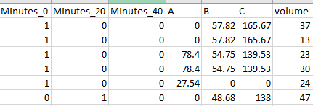
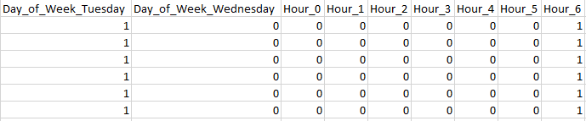
Data Pre-Preparation
????????
20-minute time interval
Removed holiday data
Additional features:
Day of the week
Average time taken to reach the tollgate
Converted data into binary format

Slide 19
Result
????????
Random Forest

Slide 20
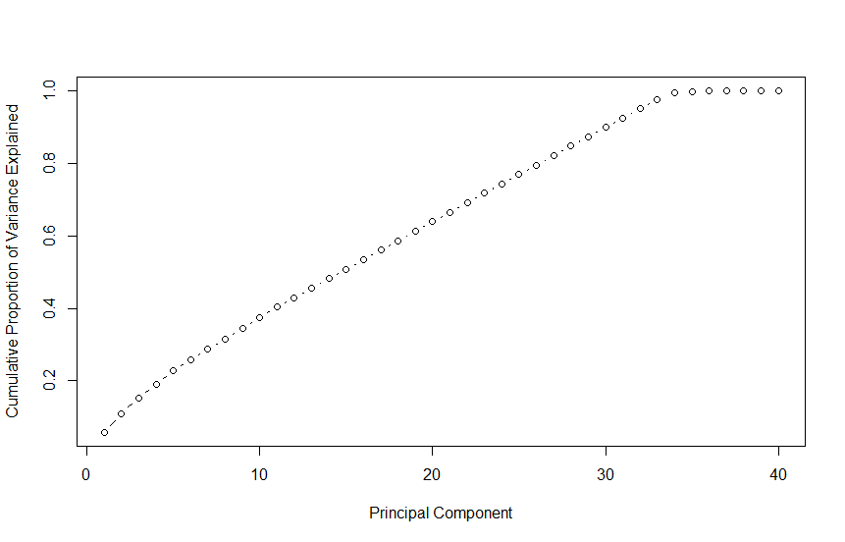
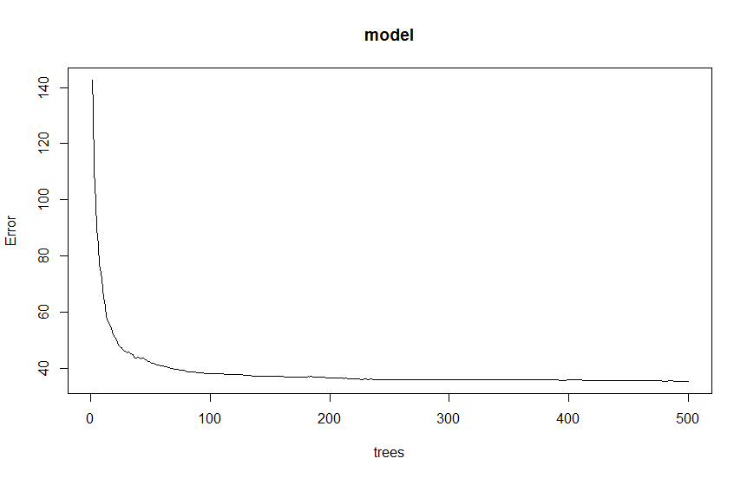
Special Mention
Performed PCA
Applied Transformation
34 PCA components = 98.6
Applied Random forest
Selected parameter ntree
Applied cross validation on test set
MAPE- 0.12 which was lowest

Slide 21
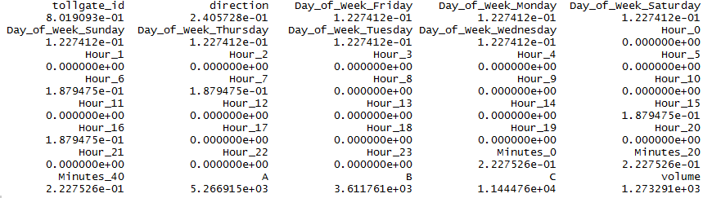
Cannot be applied to test set

Slide 22
Conclusion
Conclusion

Slide 24
Questions?
Mi Tian (mtian AT wpi DOT edu)
Deepan Sanghavi ()
Dhaval Dholakia ()

